Slide 1
Lemon Notes
Created and presented by:
Michael Cavataio, Alex Kouthoofd, and Michael Kolacki

Slide 2
Purpose and Applicability
Why a notetaking application?
We’re all students. We know the importance of taking notes and recording our thoughts.
While this can be done with a notebook and pen, in an age where so much of the information we observe, study, and review is available to us via computer, it is convenient to have something readily available anytime that information is accessible.
This has the additional benefit of providing a very intuitive structure to the Notes that are being taken; Projects may be created at any time by the user, in which any number of subject specific Notes may be recorded. When reviewing these Notes later, a user need only concern themselves with the Project of interest, and the subject of the desired Note.
The necessity to record one’s thoughts goes well beyond students
Consider a psychologist, or receptionist, or anyone with a computer readily accessible throughout the day; the ability to record one’s thoughts at whim allows the mind to be focused on other, potentially more important tasks.

Slide 3
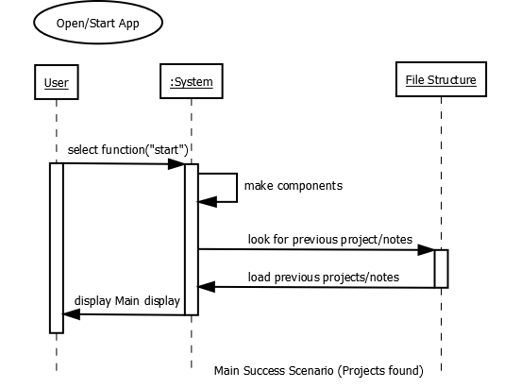
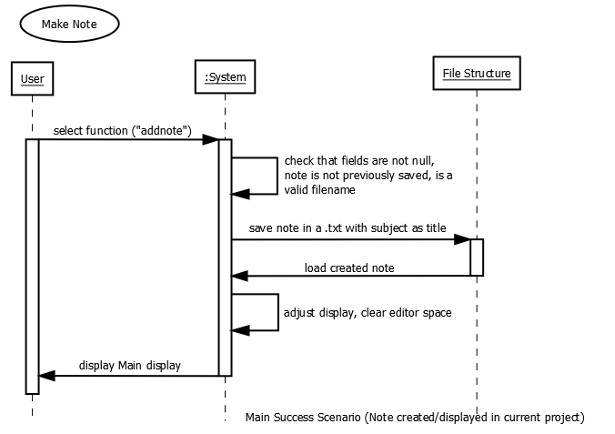
Quintessential Functionality

Slide 4
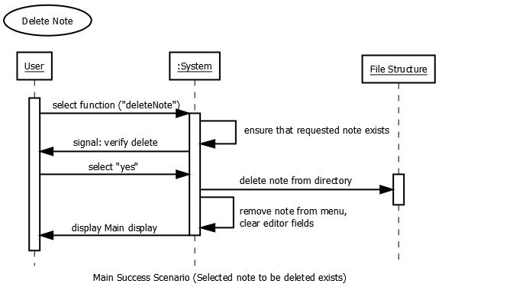
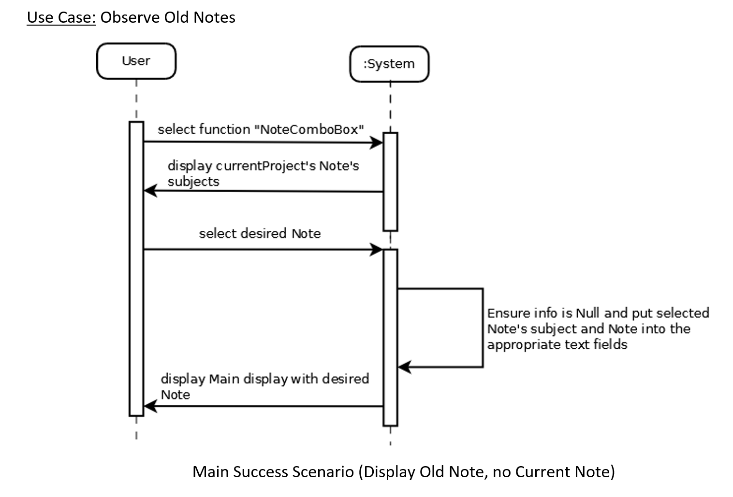
Quintessential Functionality

Slide 5
Additional Functionality
Modes – Bold, Italic, Color, Speech, and a Basic Calculator. Apply these bits of functionality with some simple delimiters!
Bold – Bolding the font of what you’re writing will certainly draw attention to critical and important sections.
Italics – Italicize that! It’ll look prettier
Color – Color your words to really make something POP, which is useful when trying to emphasize important ideas, words, phrases, definitions, etc.
Speech – Because everyone needs someone to talk to. Uses are only limited to imagination.
Basic Calculator – Useful when there are a multitude of basic operations that need performing and analyzed on the spot.

Slide 6
Usability and Aesthetic Appeal
One of the primary objectives in designing the application was to make it easily accessible to all individuals
Some people may have difficulty reading certain fonts, or certain font sizes. As an accessibility feature, these may easily be changed under Font Settings
Color is important. No one wants to look at an ugly application, and indeed some colors may be strenuous on the observer. Component-specific color is also capable of being changed as an accessibility feature under Color Settings.

Slide 7
Let’s start the app!!

